Slide 1
Almost everything you need to know about PLS
Part 2: How to perform PLS analyses in Matlab & R
Baby Example
Jenny Rieck & Derek Beaton
21 November 2017

Slide 2
A reminder:
Today’s material (code, slides) will be at:
https://github.com/derekbeaton/Workshops/tree/master/RTC/Oct2017/Part2

Slide 3
Brief PLS refresher
Standard PLS
Computed as the SVD of the cross-product matrix of X and Y
X is a matrix of observations by variables
Y is a matrix of observations by (some other) variables
Mean-centered PLS
Y is a dummy matrix that codes for experimental groups or conditions
Behavioral PLS
Individual participant X & Y matrices stacked

Slide 4
PLS Two Ways – baby example
Single subject, single run design
Same type of PLS: mean centered
a.k.a. barycentric discriminant
PLSGui
Which formats the data one way
Treating it as a block design then average
R
Which formats the data a slightly different way
Treating it as event related then average

Slide 5
Single Subject, Single Run Data
Simplest possible fMRI design

Slide 6
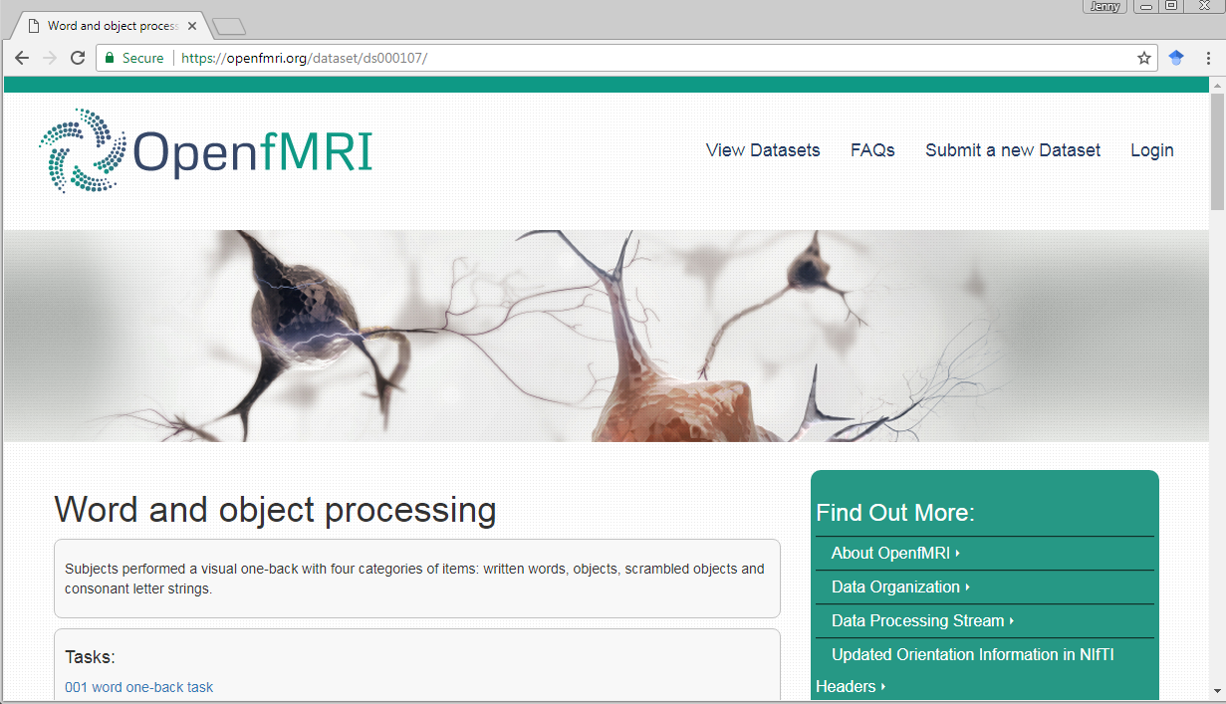
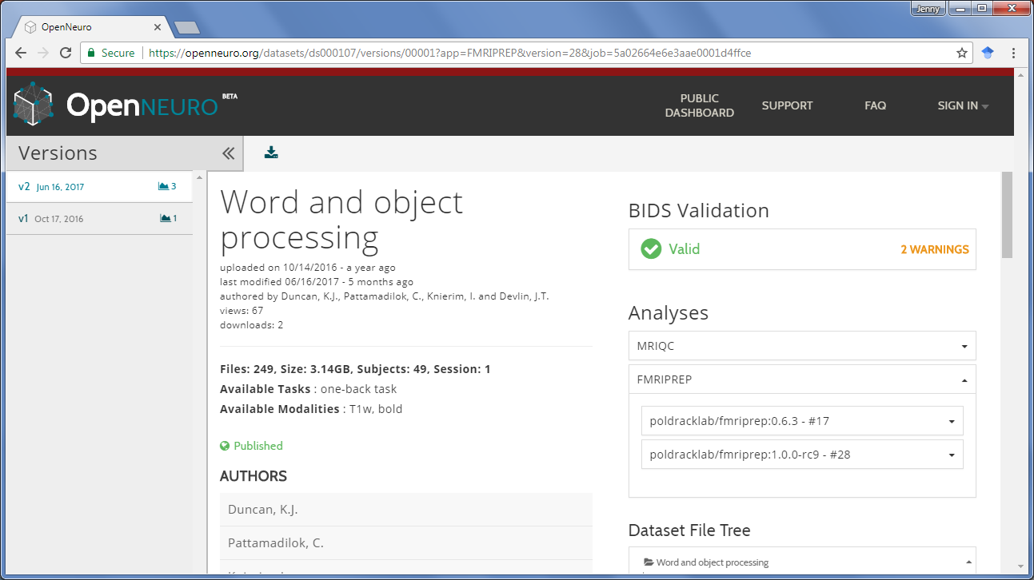
Dataset – Open fMRI ds107
Duncan KJ, Pattamadilok C, Knierim I, & Devlin JT (2009). Consistency and variability in functional localisers. Neuroimage, 46(4), 1018-1026.

Slide 7
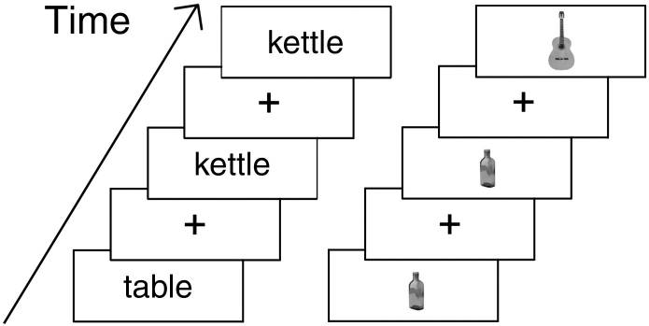
Task Design
45 participants (we’re just going to look at sub-09)
2 runs (we’re just going to look at run-01)
Block Design
Words
Pictures of Objects
Scrambled Objects
Consonant Letter Strings
Fixation
16 sec blocks
One-back task

Slide 8
Preparation for PLS
Cleaning and preprocessing
Files for:
PLSGui
In R on our own

Slide 9
Pre-Preparation for PLS
fMRI time series with preprocessing
We performed:
coregister, slice timing, smooth, normalize to a standard (i.e., MNI) space….
Mask file
Other options exist
physio corrections
detrending
censor outlier volumes
OPPNI

Slide 10
Pre-Preparation for PLS
Important aside:
Your choices of preprocessing will (very likely) change the results
Sometimes it’s mostly the same
Sometimes it’s very different
This isn’t a trivial thing

Slide 11
Preparation for PLS
In addition to preprocessed functional brain volumes we need:
(usually) experimental or task information
Onsets and durations for each experimental condition
TR length
Both PLSgui and R (in it’s current form) require TR based timing rather than sec/msec timing

Slide 12
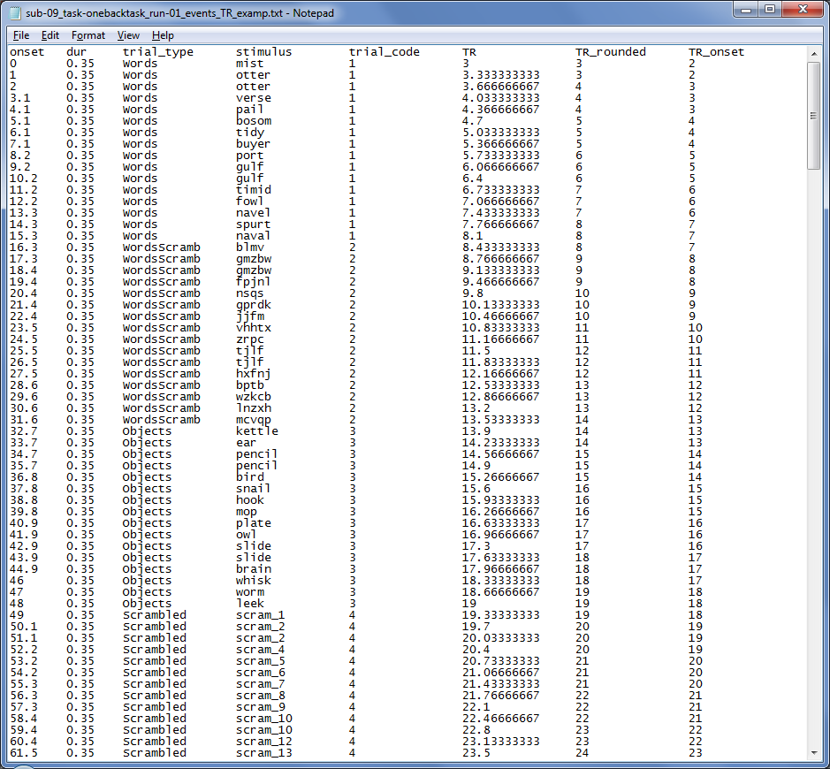
Typical experiment output file for 1 subject

Slide 13
Convert onset timing (sec) to corresponding TR #
round(onset_{sec} / TRlength_{sec})
But be mindful of experimental design and dropped volumes

Slide 14
For Block Design:
Identify Block Onset & Block Duration
Words Block #1 starts on TR #3
Words Block #1 lasts for 6 TRs
**PLSgui starts
indexing TRs at 0 **
e.g., onset of 2 would refer to the 3rd TR
Notes:
Fill Onsets fields condition by condition. Please be aware that the scan starts from 0, and unit is TR or scan, not second. i.e. If you put number 10, it refers the 11th scan image you selected.

Slide 15
How to get a brain matrix

Slide 16
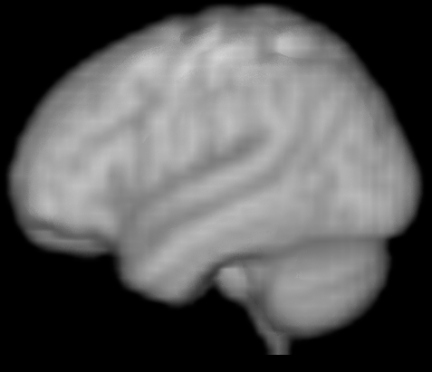
How to get a brain matrix

Slide 17
How to get a brain matrix

Slide 18
Block 1

Slide 19
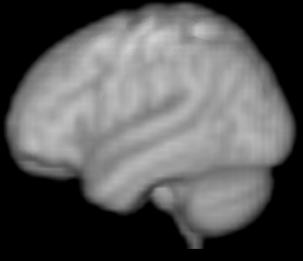
Block 1

Slide 20
Block 1

Slide 21
Block 1

Slide 22
Block 1

Slide 23
Block 1

Slide 24
Block 1

Slide 25
Block 1
 |  |  |  |  |  |  | …

Slide 26
Block 1
 |  |  |  |  |  |  | …
 |  |  |  |  |  |  | …

Slide 27
Block 1
 |  |  |  |  |  |  | …
 |  |  |  |  |  |  | …
 |  |  |  |  |  |  | …

Slide 28
Block 1
 |  |  |  |  |  |  | …
 |  |  |  |  |  |  | …
 |  |  |  |  |  |  | …
 |  |  |  |  |  |  | …

Slide 29
Block 1
 |  |  |  |  |  |  | …
 |  |  |  |  |  |  | …
 |  |  |  |  |  |  | …
 |  |  |  |  |  |  | …
 |  |  |  |  |  |  | …

Slide 30
Block 1
 |  |  |  |  |  |  | …
 |  |  |  |  |  |  | …
 |  |  |  |  |  |  | …
 |  |  |  |  |  |  | …
 |  |  |  |  |  |  | …

Slide 31
Block 1
Block 2
 |  |  |  |  |  |  | …
 |  |  |  |  |  |  | …
 |  |  |  |  |  |  | …
… | … | … | … | … | … | … | … | … | … | … | … | … | … | …
 |  |  |  |  |  |  | …
 |  |  |  |  |  |  | …
 |  |  |  |  |  |  | …

Slide 32
The two matrices we have today

Slide 33
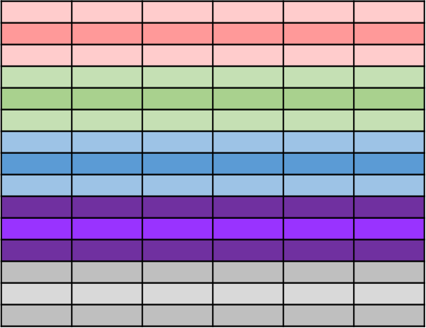
The two matrices we have today
Voxel₁
Voxel₂
. . . . .
Voxel_{N}
TR1
TR2
TR3
.
.
.
.
.
.
.
.
.
.
Time
TR164
TR165
Notes:
These are TRs (time points) across multiple blocks

Slide 34
The two matrices we have today
Voxel₁
Voxel₂
. . . . .
Voxel_{N}
TR1
Word Block 1
TR2
TR3
ScramWord
Block 1
.
.
.
.
.
.
.
.
.
.
Fix Block 1
Time
ScramWord
Block 6
TR164
TR165

Slide 35
The two matrices we have today
ScrambWord
ScrambObj
Voxel₁
Voxel₂
. . . . .
Voxel_{N}
Words
Objects
Fix
TR1
1 | 0 | 0 | 0 | 0
1 | 0 | 0 | 0 | 0
1 | 0 | 0 | 0 | 0
0 | 1 | 0 | 0 | 0
0 | 1 | 0 | 0 | 0
0 | 1 | 0 | 0 | 0
0 | 0 | 0 | 0 | 1
0 | 0 | 0 | 0 | 1
0 | 0 | 0 | 0 | 1
0 | 0 | 1 | 0 | 0
0 | 0 | 1 | 0 | 0
0 | 0 | 1 | 0 | 0
1 | 0 | 0 | 0 | 0
1 | 0 | 0 | 0 | 0
1 | 0 | 0 | 0 | 0
0 | 0 | 0 | 1 | 0
0 | 0 | 0 | 1 | 0
0 | 0 | 0 | 1 | 0
0 | 0 | 0 | 0 | 1
0 | 0 | 0 | 0 | 1
0 | 0 | 0 | 0 | 1
0 | 0 | 1 | 0 | 0
0 | 0 | 1 | 0 | 0
0 | 0 | 1 | 0 | 0
0 | 1 | 0 | 0 | 0
0 | 1 | 0 | 0 | 0
0 | 1 | 0 | 0 | 0
Word Block 1
TR2
TR3
ScramWord
Block 1
.
.
.
.
.
.
.
.
.
.
Fix Block 1
Time
ScramWord
Block 6
TR164
TR165

Slide 36
PLS Two Ways
PLSGui way
“Black box” approach
How we do it in R
We’re making cardboard, building, and then painting boxes!

Slide 37
PLS Two Ways
Same type of PLS: mean centered
a.k.a. barycentric discriminant
PLSGui
Which formats the data one way
Treating it as a block design then average
R
Which formats the data a slightly different way
Treating it as event related then average

Slide 38
PLSgui Pipeline
What we need to do:
Create individual datafiles (datamats) for each participant
fMRIsessiondata.mat files
specifying time series files, condition onsets and durations, and additional preprocessing steps
Run chosen PLS analysis
fMRIresult.mat file
View your results and interpret

Slide 39
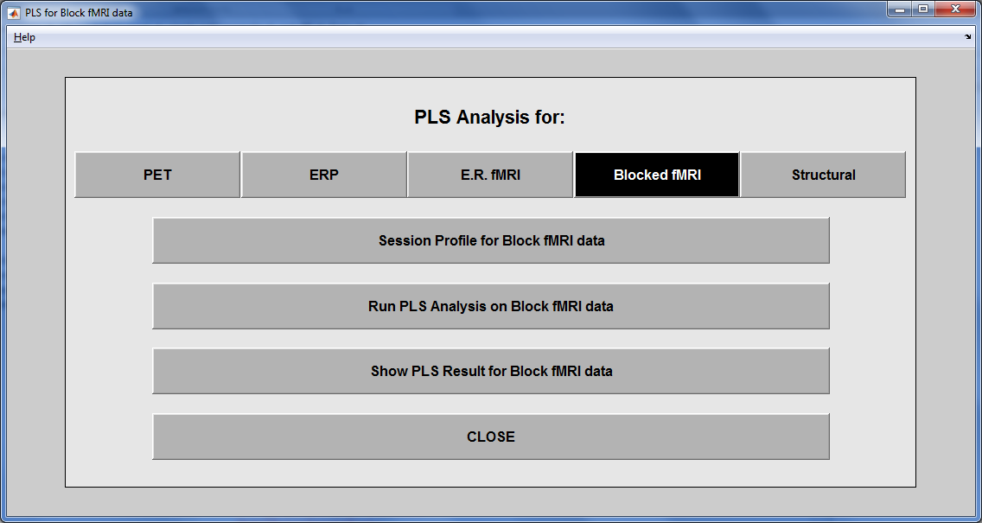

Slide 40
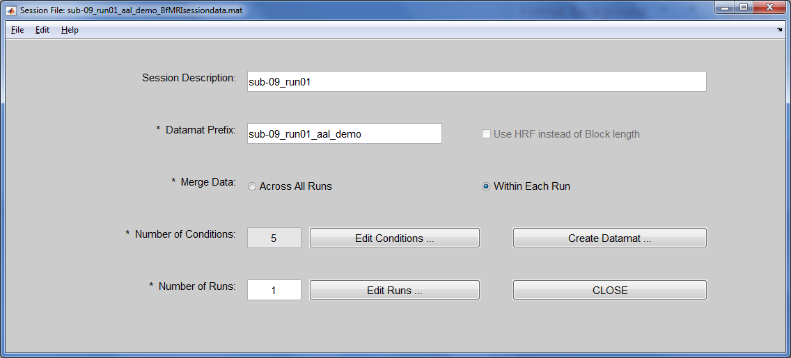
Notes:
Session Description is an optional field.
Datamat Prefix is used to compose sessiondata file name.
Merge Data:
Across All Runs (default): data will be averaged together across all runs for the same condition names.
Within Each Runs, the same condition name in different runs will be treated as different conditions. So the actual conditions will be automatically expand to something like Run1Cond1, Run1Cond2, Run2Cond1, etc.

Slide 41
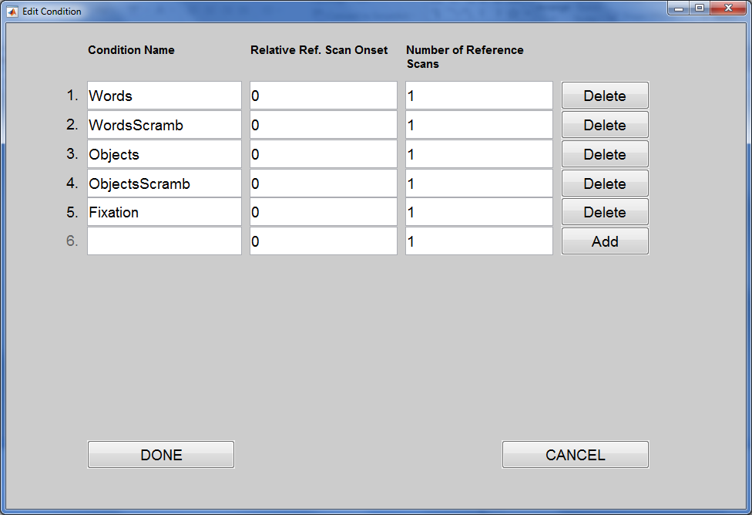
By default, data are normalized to a reference scan (i.e., first scan of each block)
How many scans to be used as a reference? (default = 1)
Offset of the first reference scan from the onset (default = 0)
Notes:
Relative Ref. Scan Onset refers the offset of the first reference scan from the first scan of each onset. Negative value means that reference scan starts before the first scan of each onset. By default, it is 0.
Number of Reference Scans means how many scans after the first reference scan will be averaged together to become a reference scan. By default, it is 1, which means that only 1 scan is used for reference scan.

Slide 42
Notes:
Session Description is an optional field.
Datamat Prefix is used to compose sessiondata file name.
Merge Data:
Across All Runs (default): data will be averaged together across all runs for the same condition names.
Within Each Runs, the same condition name in different runs will be treated as different conditions. So the actual conditions will be automatically expand to something like Run1Cond1, Run1Cond2, Run2Cond1, etc.

Slide 43
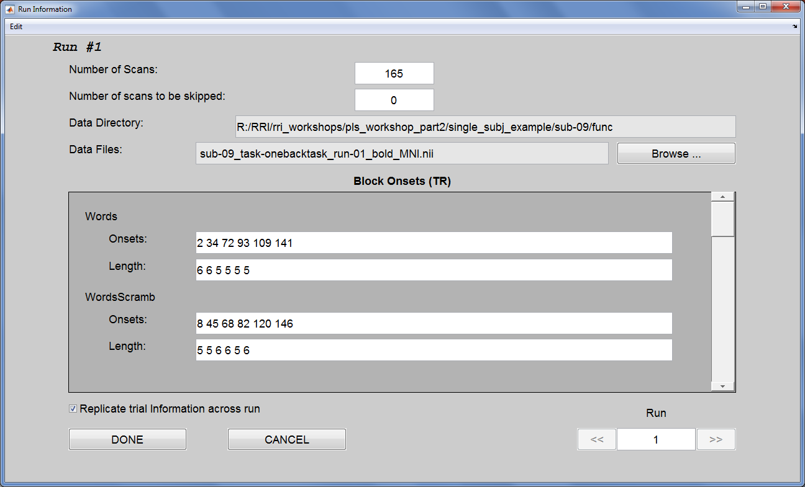
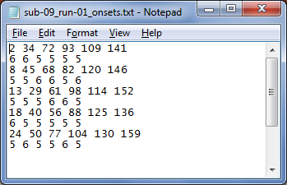
File -> Load onsets from a text file
first (in this case, only) run of data
Block onsets and block lengths
(remember PLSgui starts indexing TRs at 0!)
Notes:
Number of Scans field must be specified first in this window.
Number of scans to be skipped is not 0, the first several scans in this run to be skipped should not be included in the Data Files, and Number of Scans should reflects the actual number of un-skipped scans. The onset number in the fields below still starts from the very first scan of this run. If the onsets that you entered are within the skipped scans, they will be excluded when the datamat is created
Onsets: Please be aware that the scan starts from 0, and unit is TR or scan, not second. i.e. If you put number 10, it refers the 11th scan image you selected.
If you have many onset numbers in a field, we suggest you to prepare them in text files. One text file for each run, each line stands for a condition, and all onsets for that condition are separated by a space and listed on that condition line. Click Load Onsets from a text file for this run under Edit menu to let the PLS applications fill the onset numbers for you. Click Save Onsets to a text file for this run will save the current filled numbers to a text file.

Slide 44
Notes:
Session Description is an optional field.
Datamat Prefix is used to compose sessiondata file name.
Merge Data:
Across All Runs (default): data will be averaged together across all runs for the same condition names.
Within Each Runs, the same condition name in different runs will be treated as different conditions. So the actual conditions will be automatically expand to something like Run1Cond1, Run1Cond2, Run2Cond1, etc.

Slide 45
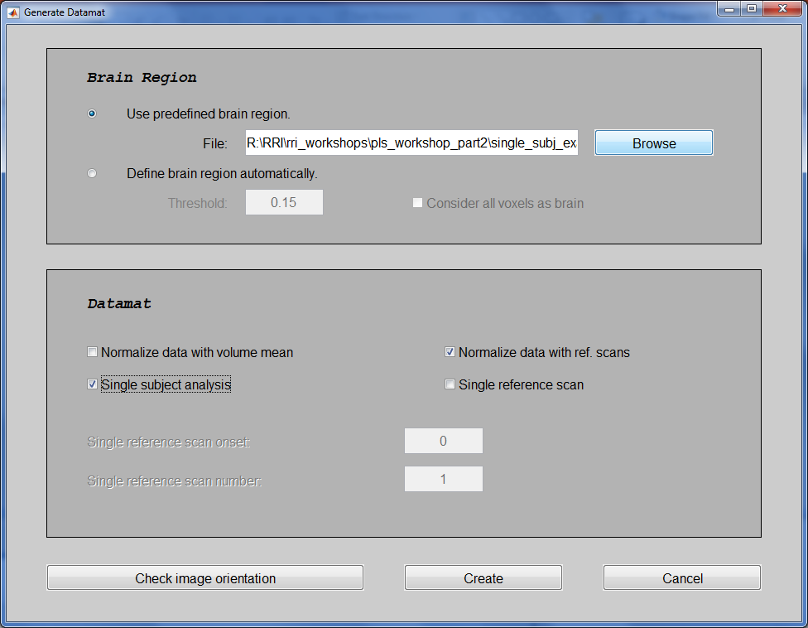
User specified brain mask
By default, data are normalized to a reference scan (i.e., first scan of each block).
Normalization is done by computing % signal change from the reference scan
Each onset block will be considered as a separate occurrence (rather than averaging over the entire condition)
Notes:
Normalize data with volume mean: datamat value will be the stacked volume intensity divided by the average intensity for each volume; otherwise, datamat value will just be the stacked volume intensity. Please be aware that by default Normalize data with volume meanis not checked for both E.R.fMRI and Blocked fMRI data. Don't select this check box unless you have good reason to do so.
Normalize data with ref. scans: datamat will be normalized by the selected ref. scans. Please be aware that by default Normalize data with ref. scans is selected for both E.R.fMRI and Blocked fMRI data to prevent huge DC offset (low frequency noise).
Single subject analysis is only used to analyze single subject with very few onsets. If this check box is selected, each onset block will be stacked as a separate volume. So, datamat will only be averaged within each onset block, rather than within each condition.
Single reference scan will use the reference scan below for all the scans in the datamat, which will replace whatever Relative Ref. Scan Onset and Number of Reference Scans that you set in the Edit Condition window. It is also only used when you select the Normalize data with ref. scanscheck box. In Single reference scan onset edit box below, you enter an absolute reference scan onset, instead of a relative reference scan onset.

Slide 46
Brain matrix made by PLSGui
It’s not the TR (time point) matrix anymore
Block designs
For each block
Step 1: Pick a reference TR for the block
Step 2: Compute % change in all block TRs from reference TR
Step 3: Average all TRs in a block
Each block belongs to a different condition

Slide 47
Our 2 matrices in PLSgui
Voxel₁
Voxel₂
. . . . .
Voxel_{N}
Words_{Block1}
.
.
.
Words_{Block6}
ScrambWords_{Block1}
.
.
.
Objects_{Block1}
.
.
.
ScrambObjects_{Block1}
.
.
.
.
.
.
Fixation_{Block6}

Slide 48
Our 2 matrices in PLSgui
Voxel₁
Voxel₂
. . . . .
Voxel_{N}
ScrambWord
ScrambObj
Words
Objects
Fix
Words_{Block1}
.
.
.
1 | 0 | 0 | 0 | 0
1 | 0 | 0 | 0 | 0
1 | 0 | 0 | 0 | 0
1 | 0 | 0 | 0 | 0
1 | 0 | 0 | 0 | 0
1 | 0 | 0 | 0 | 0
0 | 1 | 0 | 0 | 0
0 | 1 | 0 | 0 | 0
0 | 1 | 0 | 0 | 0
0 | 1 | 0 | 0 | 0
0 | 1 | 0 | 0 | 0
0 | 1 | 0 | 0 | 0
0 | 0 | 1 | 0 | 0
0 | 0 | 1 | 0 | 0
0 | 0 | 1 | 0 | 0
0 | 0 | 1 | 0 | 0
0 | 0 | 1 | 0 | 0
0 | 0 | 1 | 0 | 0
0 | 0 | 0 | 1 | 0
0 | 0 | 0 | 1 | 0
0 | 0 | 0 | 1 | 0
0 | 0 | 0 | 1 | 0
0 | 0 | 0 | 1 | 0
0 | 0 | 0 | 1 | 0
0 | 0 | 0 | 0 | 1
0 | 0 | 0 | 0 | 1
0 | 0 | 0 | 0 | 1
0 | 0 | 0 | 0 | 1
0 | 0 | 0 | 0 | 1
0 | 0 | 0 | 0 | 1
Words_{Block6}
ScrambWords_{Block1}
.
.
.
Objects_{Block1}
.
.
.
ScrambObjects_{Block1}
.
.
.
.
.
.
Fixation_{Block6}

Slide 49
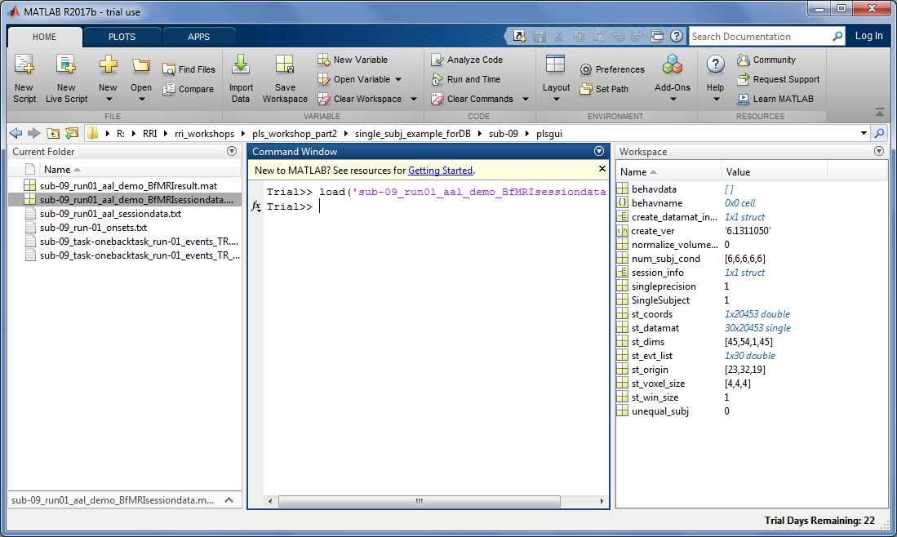
Everything we just did lives in BfMRIsessiondata.mat

Slide 50
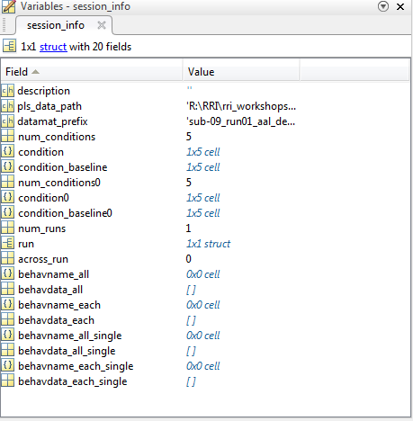
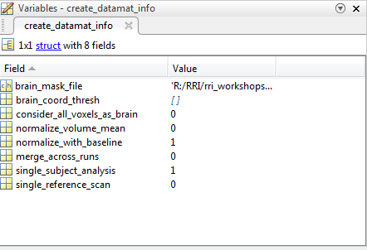
Everything we just did lives in BfMRIsessiondata.mat
Participant specific info
Additional preprocessing info

Slide 51
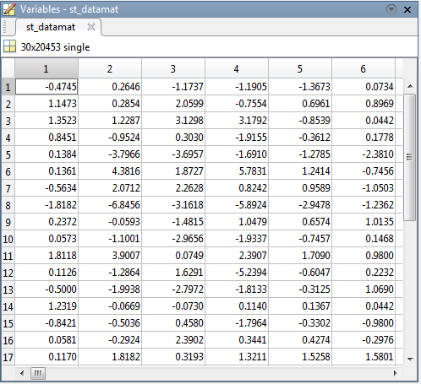
st_datamat is our X matrix

Slide 52
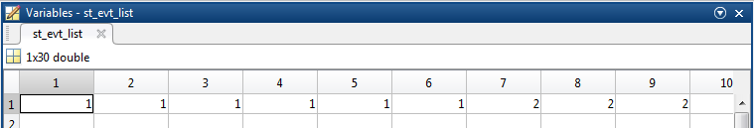
st_evt_list is our Row design (condition labels)

Slide 53
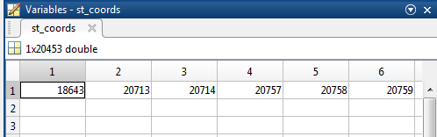
st_coords is our Column design (voxel indices)

Slide 54
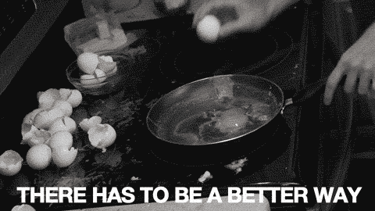

Slide 55


There is a better way!
Clicking is tedious and prone to error
batch files allow you to specify each step in the creation of sessiondata.mat files
Keep a record of how sessiondata.mat files were created
Pull in onsets directly from experiment files

Slide 56
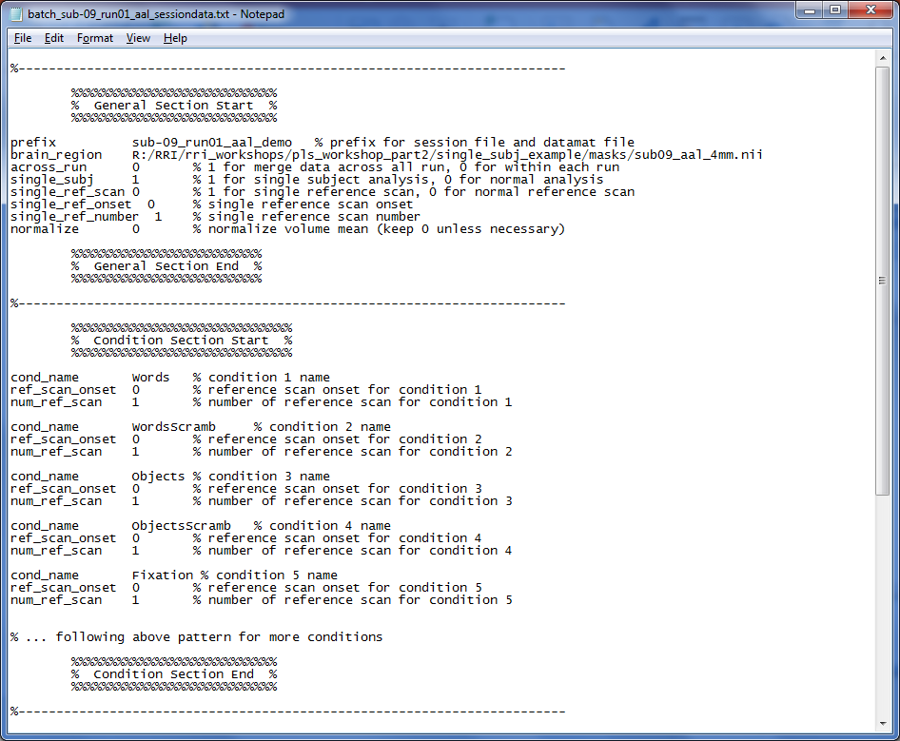
File name and preprocessing specs
PLSgui batch file for block design
“Edit Conditions” specs
Condition names
Ref Scan specs

Slide 57
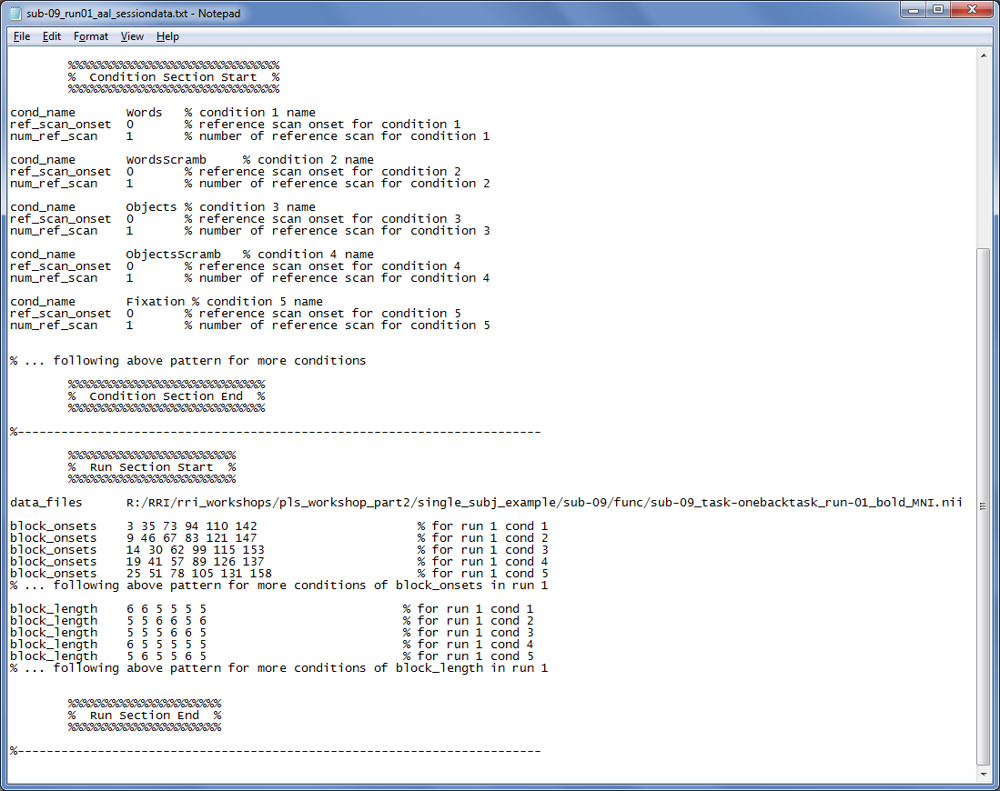
PLSgui batch file for block design
“Edit Runs” specs
Data files
Block Onsets
Block Length

Slide 59
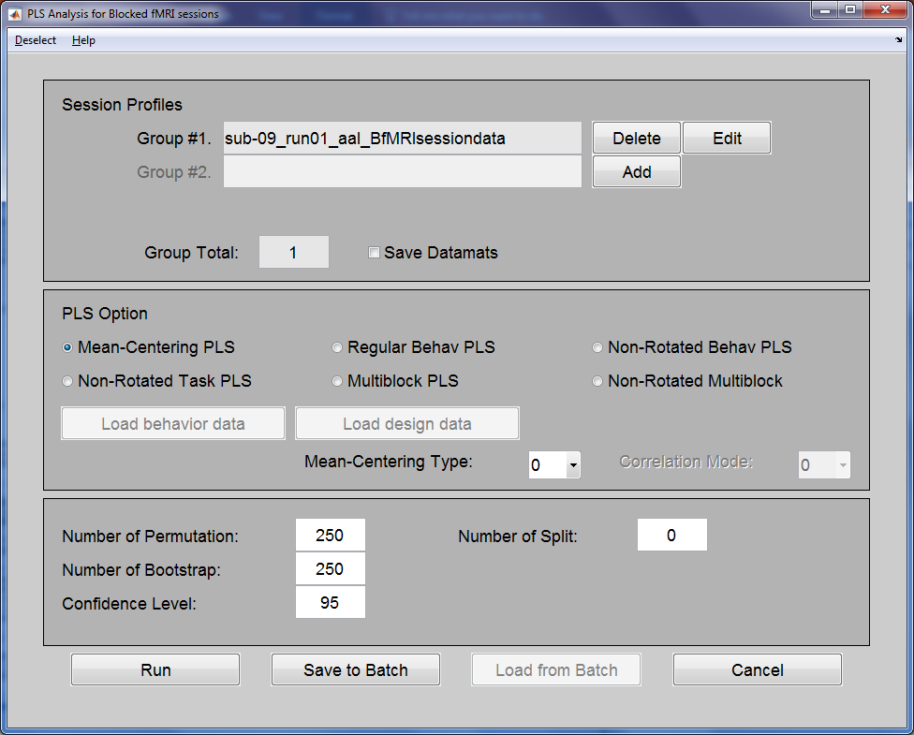
Deselect conditions
Load the sessiondata.mat we just created
Resampling specs
Notes:
0 - (default) Within each group remove group means from conditon means. Tells us how conditions are modulated by group membership. Boosts condition differences, removes overall group differences. Best suited if you are interested in condition and condition- by-group effects.
1 - Remove grand condition means from each group condition mean. Tells us how conditions are modulated by group membership. Boosts group differences, removes overall condition differences. Best suited if you are interested in group and group-by-condition effects.
2 - Remove grand mean (over all subjects and conditions). Tells us full spectrum of condition and group effects (group, conditions and group-by-condition).
3 - Remove all main effects, subtract condition and group means (group by condition). This type of analysis will deal with pure group by condition interaction.

Slide 60
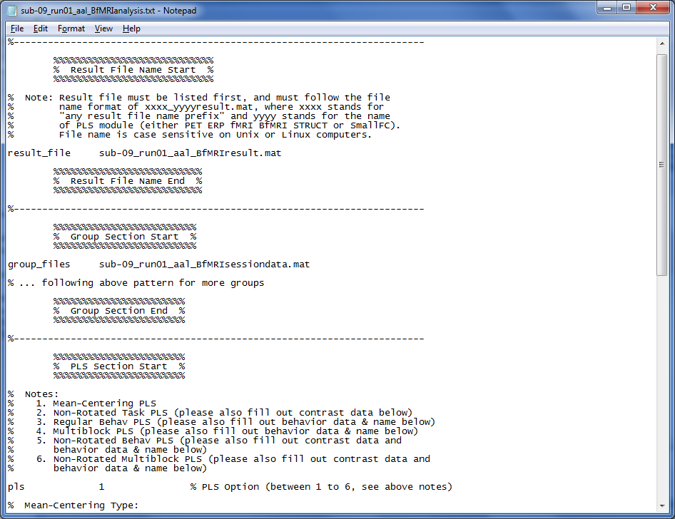
PLSgui batch file for block analysis
Specify the sessiondata.mat
Specify PLS analysis type

Slide 61
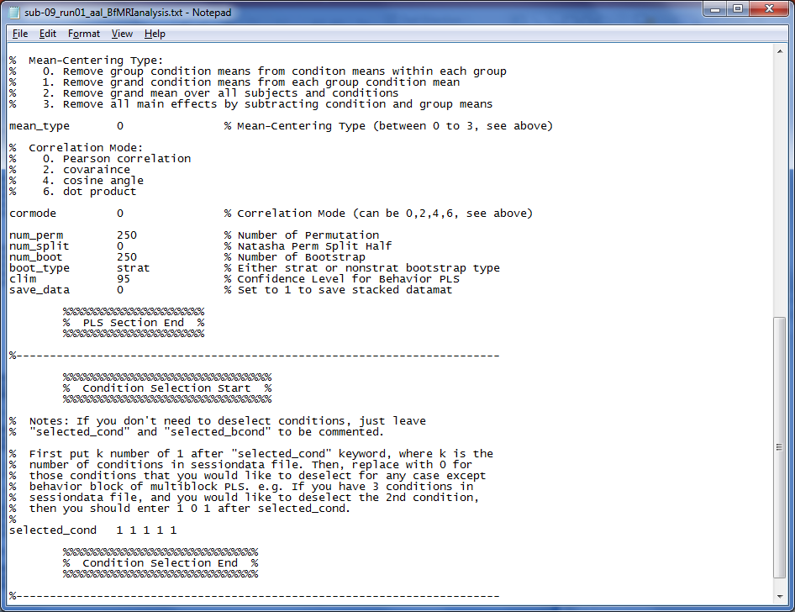
Specify mean centering type
PLSgui batch file for block analysis
Specify resampling
Specify which conditions to analyze

Slide 63
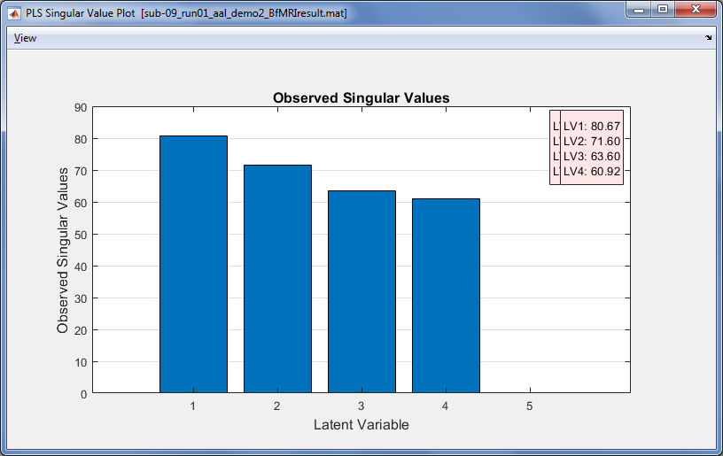
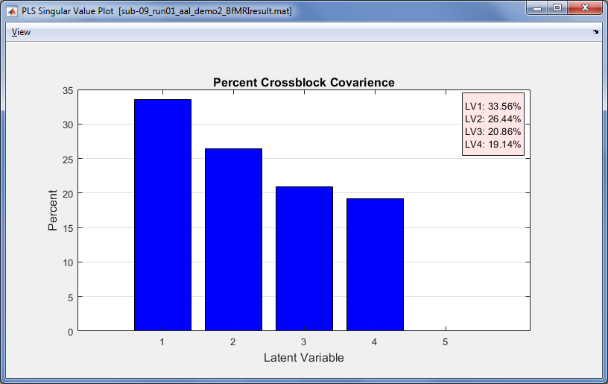
PLS Singular Value Plot
PLSgui scree plots
LV1 explains 33.5% covariance

Slide 64
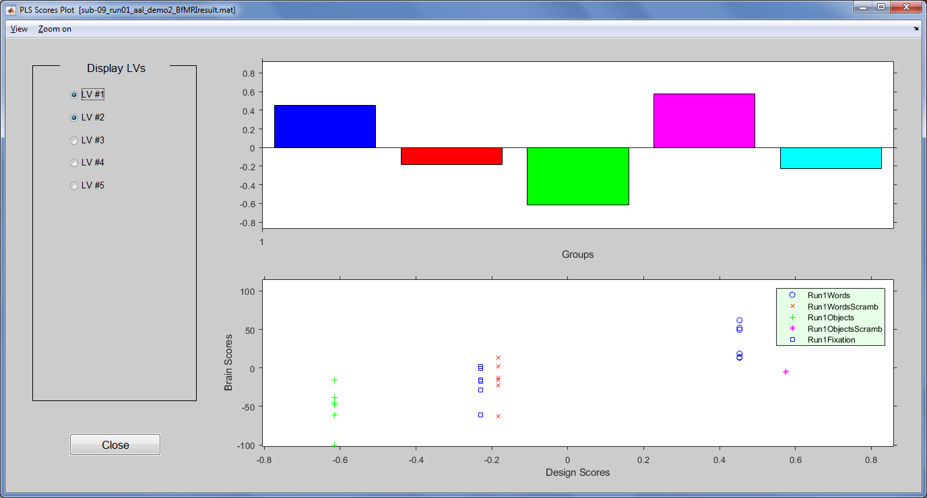
Design scores for LV 1
Objects vs Scrambled Objects

Slide 65
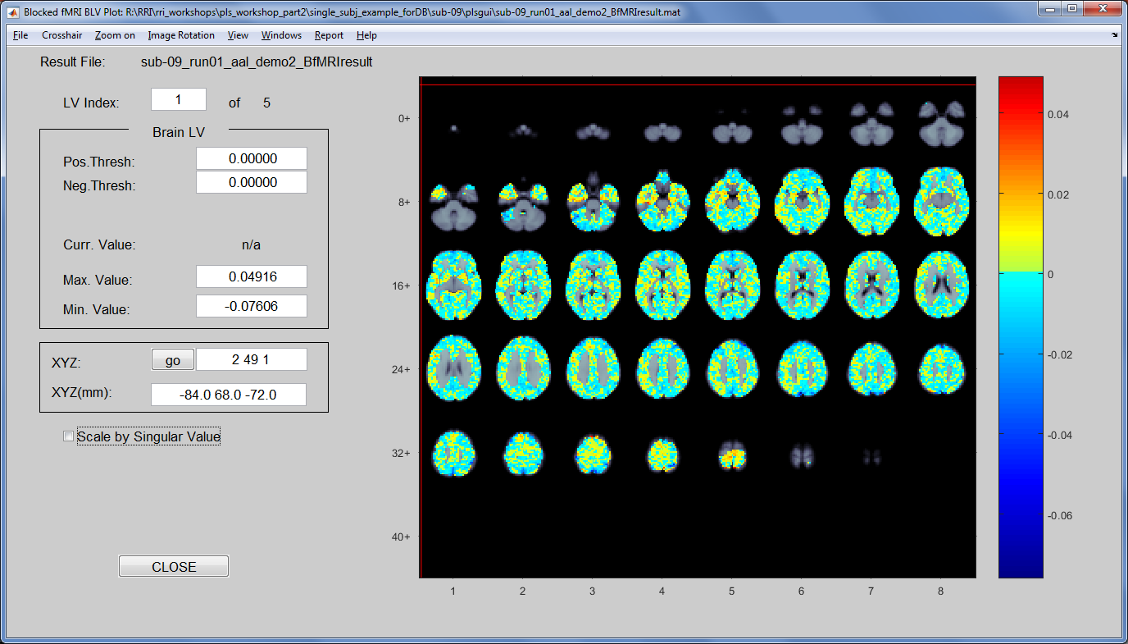
Brain Scores for LV 1

Slide 66
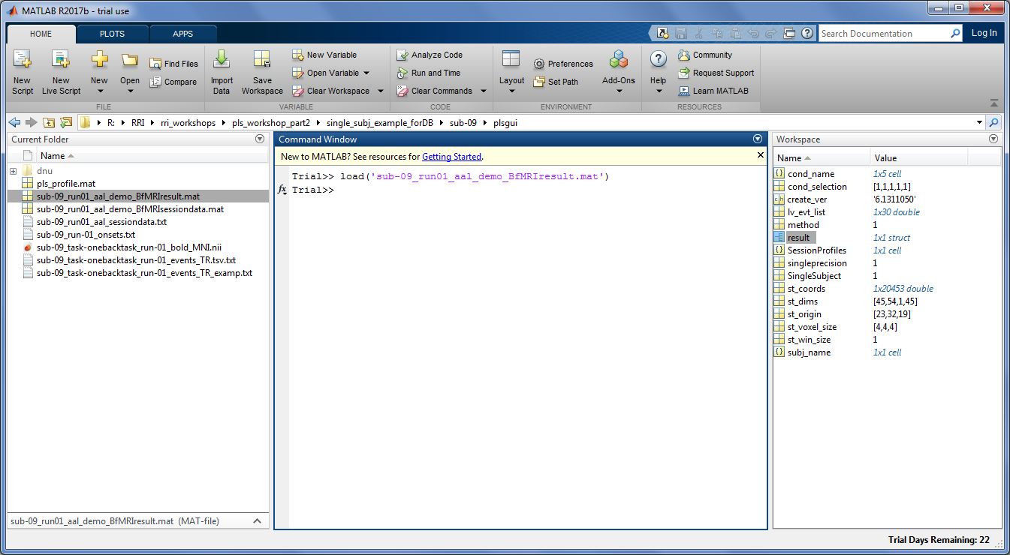
All the results live in BfMRIresult.mat

Slide 67
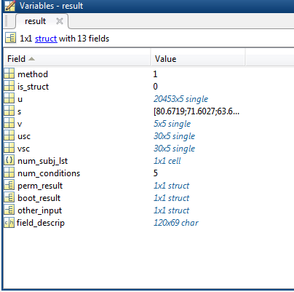
BfMRIresult.mat
u: Brain singular vectors
s: Singular values
v: Design singular vectors
usc: Brain scores (Brain latent variable)
vsc: Design scores (Design latent variable)
Notes:
u: Brainlv or Salience
s: Singular value
v: Designlv or Behavlv
usc: Brainscores or Scalpscores
vsc: Designscores or Behavscores
datamatcorrs_lst: Correlation of behavior data with datamat, only available in behavior PLS
lvcorrs: Correlation of behavior data with usc, only available in behavior PLS
perm_result: struct containing permutation result
perm_splithalf: struct containing permutation splithalf
boot_result: struct containing bootstrap result

Slide 68
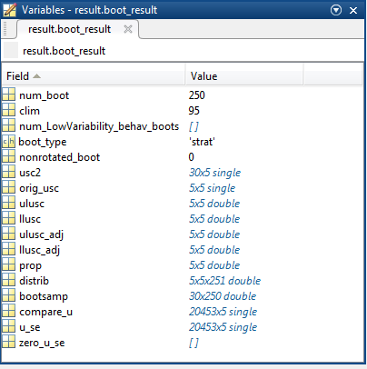
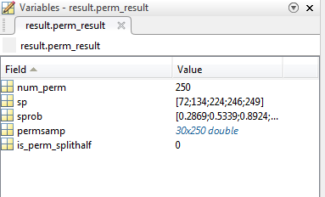
BfMRIresult.mat – resampling

Slide 69
PLSgui summary
3 main steps
Creating datamat file from time series data
Requires some additional choices about preprocessing the data matrices
We chose to look at blocks over time
Run PLS analysis
Standard mean-center approach
Interpret results through PLSgui viewers

Slide 70
PLSgui summary
Clicking and manual entry is an easy place to start
But can be semi-automated through batch files
For our single-subject analysis
Largest difference in brain function was for objects vs scrambled objects
All data files, specs and results stored in .mat files
Keep track of how you ran your analyses
Export data for prettier visualizations (bar graphs, brain maps)

Slide 71
A bit of a breather?

Slide 72
PLS Two Ways
Same type of PLS: mean centered
a.k.a. barycentric discriminant
PLSGui
Which formats the data one way
Treating it as a block design then average
R
Which formats the data a slightly different way
Treating it as event related then average

Slide 73
PLS in R
R libraries
oro.nifti
TInPosition

Slide 74
PLS in R
What we’ll need:

Slide 75
The two matrices we have today
ScrambWord
ScrambObj
Voxel₁
Voxel₂
. . . . .
Voxel_{N}
Words
Objects
Fix
TR1
1 | 0 | 0 | 0 | 0
1 | 0 | 0 | 0 | 0
1 | 0 | 0 | 0 | 0
0 | 1 | 0 | 0 | 0
0 | 1 | 0 | 0 | 0
0 | 1 | 0 | 0 | 0
0 | 0 | 0 | 0 | 1
0 | 0 | 0 | 0 | 1
0 | 0 | 0 | 0 | 1
0 | 0 | 1 | 0 | 0
0 | 0 | 1 | 0 | 0
0 | 0 | 1 | 0 | 0
1 | 0 | 0 | 0 | 0
1 | 0 | 0 | 0 | 0
1 | 0 | 0 | 0 | 0
0 | 0 | 0 | 1 | 0
0 | 0 | 0 | 1 | 0
0 | 0 | 0 | 1 | 0
0 | 0 | 0 | 0 | 1
0 | 0 | 0 | 0 | 1
0 | 0 | 0 | 0 | 1
0 | 0 | 1 | 0 | 0
0 | 0 | 1 | 0 | 0
0 | 0 | 1 | 0 | 0
0 | 1 | 0 | 0 | 0
0 | 1 | 0 | 0 | 0
0 | 1 | 0 | 0 | 0
Word Block 1
TR2
TR3
ScramWord
Block 1
.
.
.
.
.
.
.
.
.
.
Fix Block 1
Time
ScramWord
Block 6
TR164
TR165

Slide 76
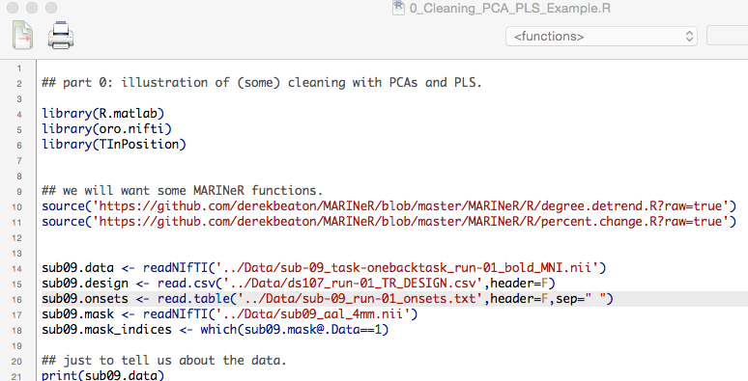

Slide 81
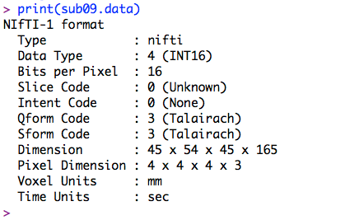

Slide 83
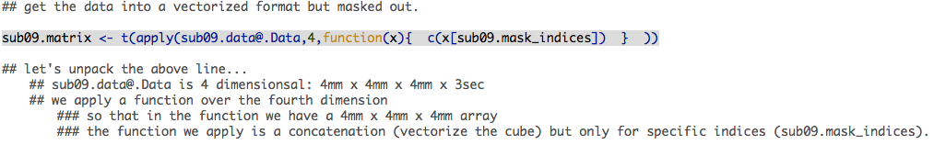

Slide 85
Concatenate (vectorize)

Slide 86
Over the fourth dimension (time)

Slide 89
Transpose

Slide 90
TR (time) x Voxels (brain only)

Slide 91
PLS in R
Before we do our PLS let’s talk about some of the preprocessing possibilities and issues
With TRs you’re going to see temporal effects
i.e., scanner drift

Slide 92
PLS in R
We’ll talk about two additional levels of preprocessing needed for analyses:
Temporal detrend
TR normalization
We’re going to step through these a bit and visualize with a PCA of just the fMRI data

Slide 93
Important analysis rule
Visualize everything!
Two variables? → Scatterplot
More than two? → Be lazy and do a PCA

Slide 94
Cleaning & PCA in R
Code for this found in 0_Cleaning_PCA_PLS_Example.R at https://github.com/derekbeaton/Workshops/tree/master/RTC/Oct2017/Part2/R/Code

Slide 95
PCA of TR x Voxels
As is

Slide 96
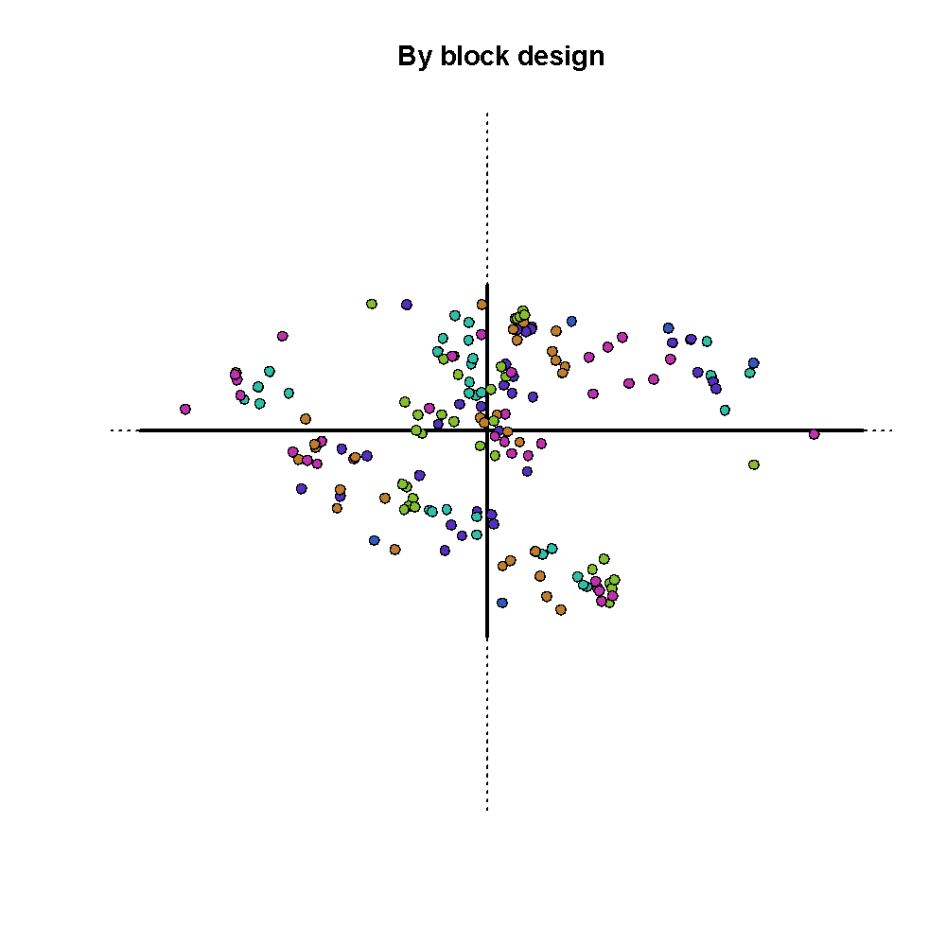
Notes:
Data as is, colored by word/object/scramble, etc…

Slide 97
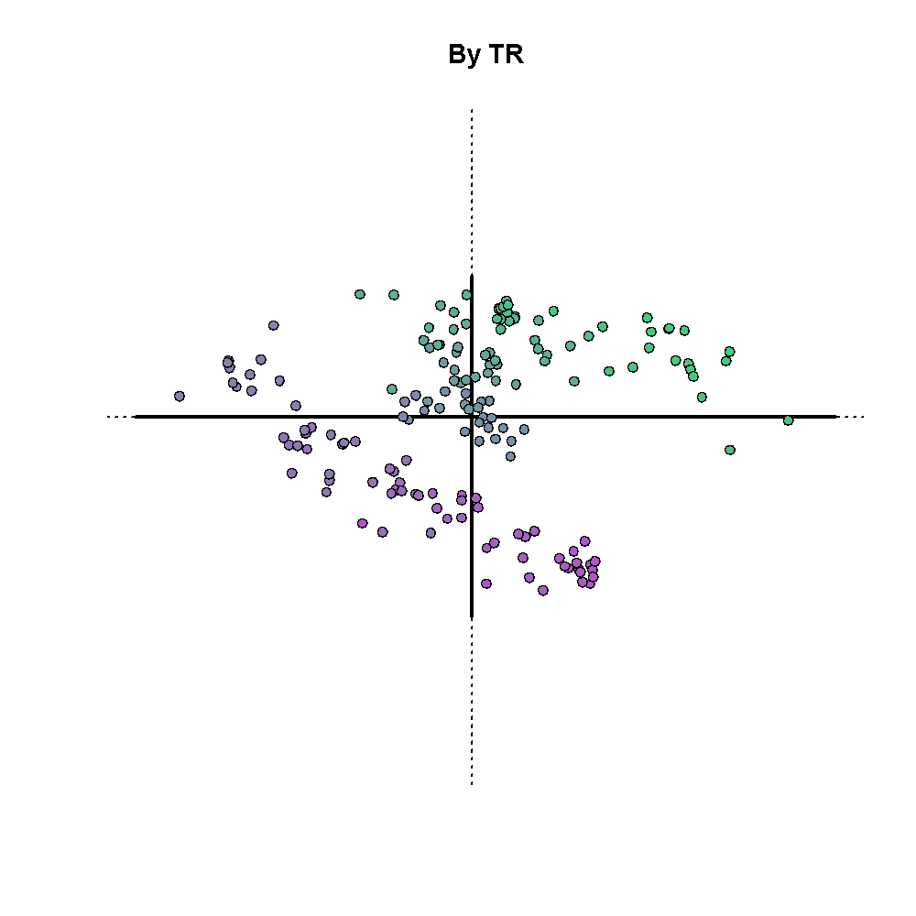
Notes:
Data as is colored by time: the most purple is the first TR, the most green is the last TR.
That looks weird!

Slide 98
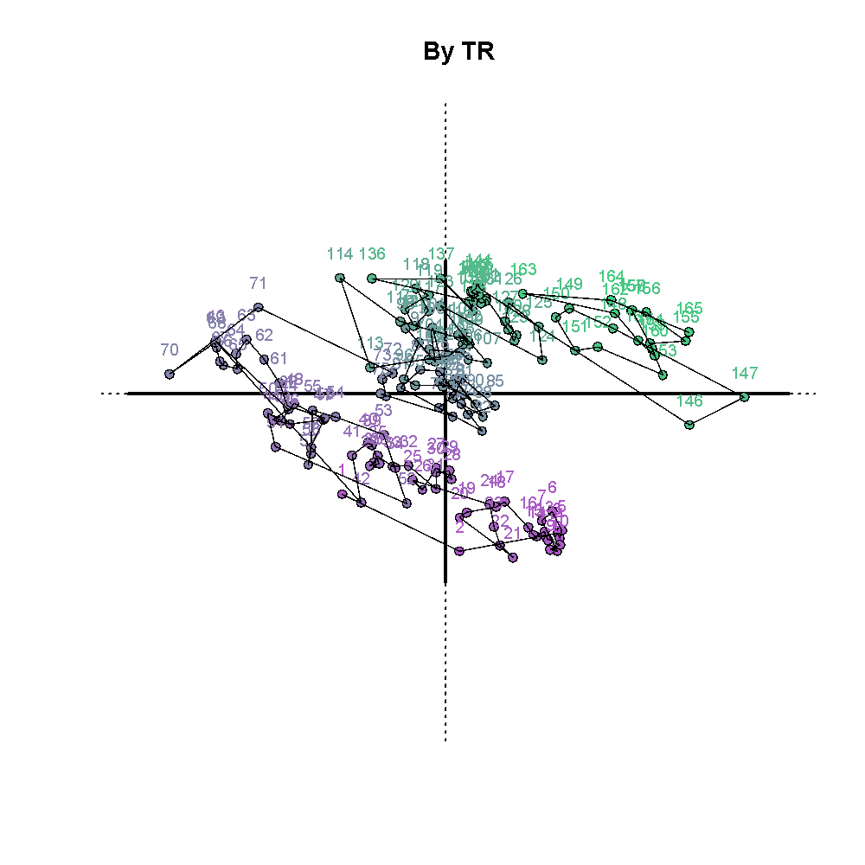
Early TRs
Notes:
Data as is colored by time: the most purple is the first TR, the most green is the last TR.
That looks weird!
Make some arrows here to how the groups of TRs, roughtly the first 10-20, next 10-20, and so on…
Then a final arrow to show a broad temporal effect

Slide 99
TRs 55-70
Notes:
Data as is colored by time: the most purple is the first TR, the most green is the last TR.
That looks weird!
Make some arrows here to how the groups of TRs, roughtly the first 10-20, next 10-20, and so on…
Then a final arrow to show a broad temporal effect

Slide 100
Middle TRs
Notes:
Data as is colored by time: the most purple is the first TR, the most green is the last TR.
That looks weird!
Make some arrows here to how the groups of TRs, roughtly the first 10-20, next 10-20, and so on…
Then a final arrow to show a broad temporal effect

Slide 101
TRs 115-140
Notes:
Data as is colored by time: the most purple is the first TR, the most green is the last TR.
That looks weird!
Make some arrows here to how the groups of TRs, roughtly the first 10-20, next 10-20, and so on…
Then a final arrow to show a broad temporal effect

Slide 102
Last TRs
Notes:
Data as is colored by time: the most purple is the first TR, the most green is the last TR.
That looks weird!
Make some arrows here to how the groups of TRs, roughtly the first 10-20, next 10-20, and so on…
Then a final arrow to show a broad temporal effect

Slide 103
PCA of TR x Voxels
Not so good!

Slide 104
Temporal detrend
What is it and how it works?
Remove the effects of time (scanner drift)
Residuals from polynomial regression

Slide 105
PCA of TR x Voxels
Polynomial 1 (linear)

Slide 106
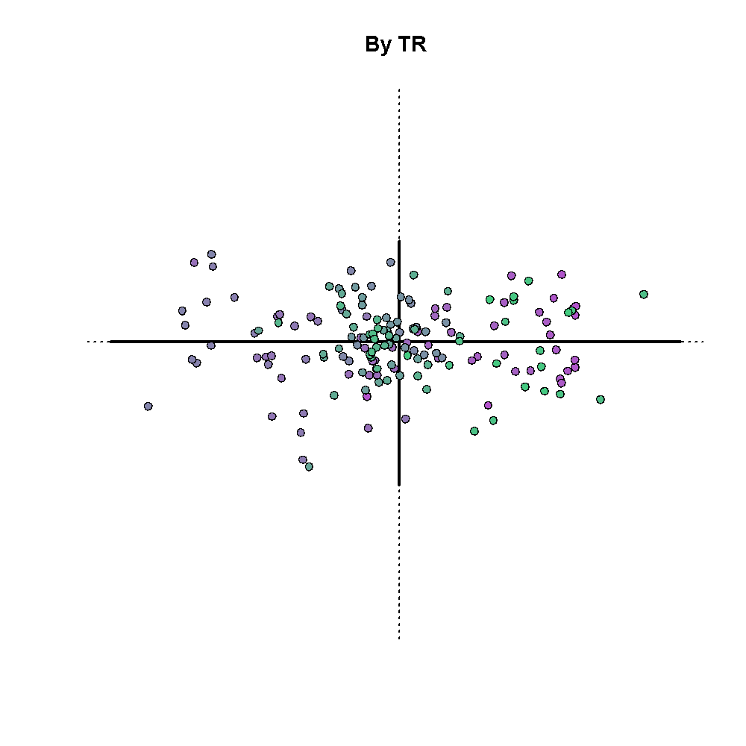

Slide 107
Last TRs
Early TRs
Notes:
Show here that the first and last TRs are now kind of still clumped together…

Slide 108
PCA of TR x Voxels
Polynomial 2 (linear + quadratic)

Slide 109
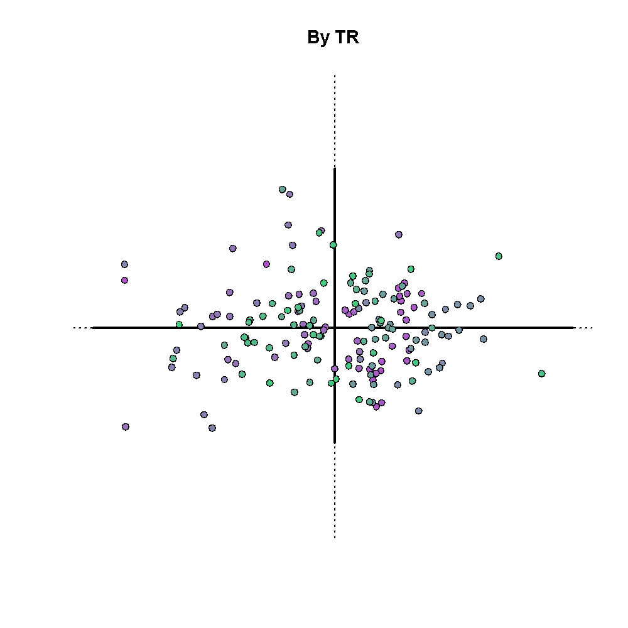

Slide 110
PCA of TR x Voxels
Polynomial 2 (linear + quadratic)
Row normalization
Emphasis on patterns across voxels not magnitude per time point

Slide 111
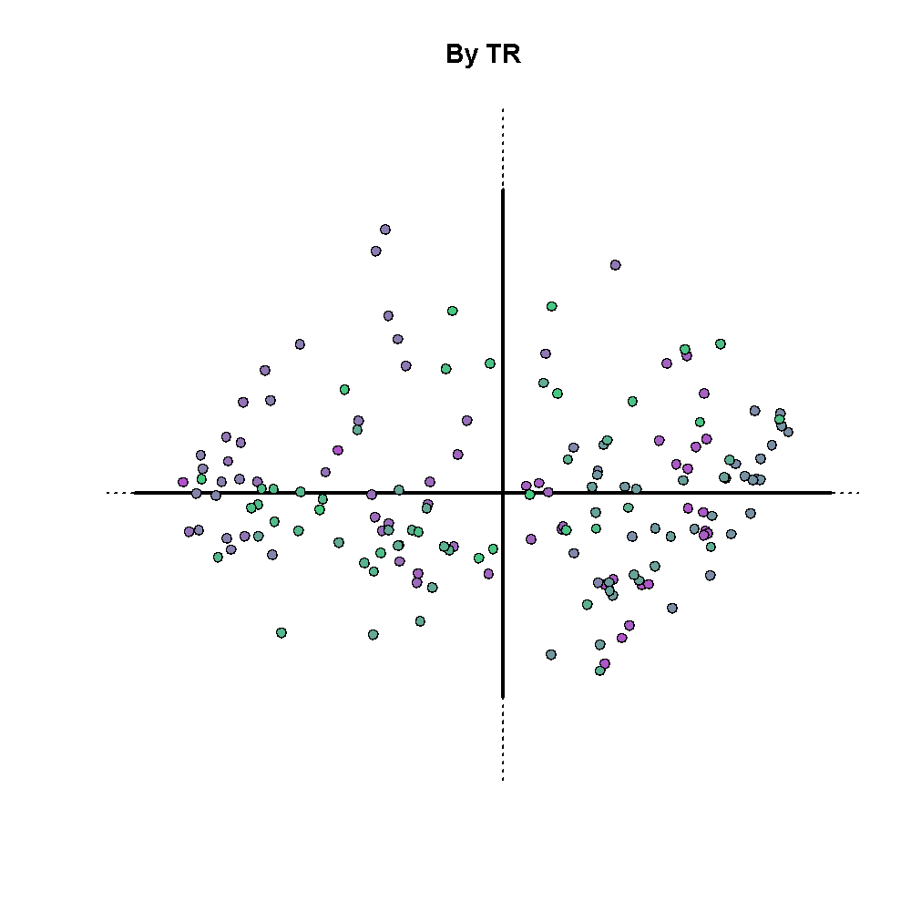

Slide 112
PLS in R
Let’s actually do PLS
Code for this is in 1_PreprocPLSInferenceVisualize.R at https://github.com/derekbeaton/Workshops/tree/master/RTC/Oct2017/Part2/R/Code

Slide 113
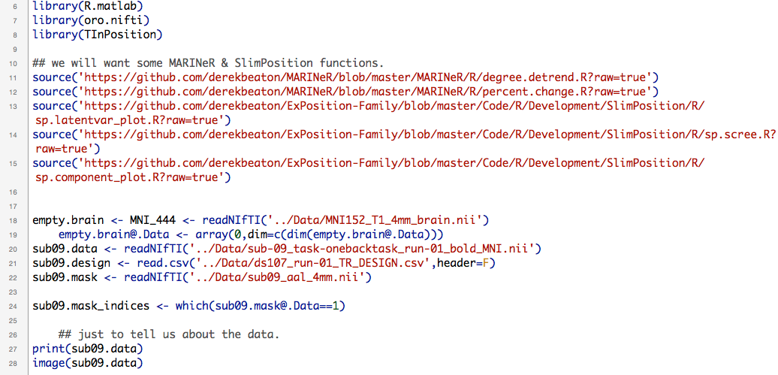
PLS in R

Slide 114
Important analysis rule
Visualize everything!
Inspect those brains

Slide 115
PLS in R

Slide 116
PLS in R

Slide 117
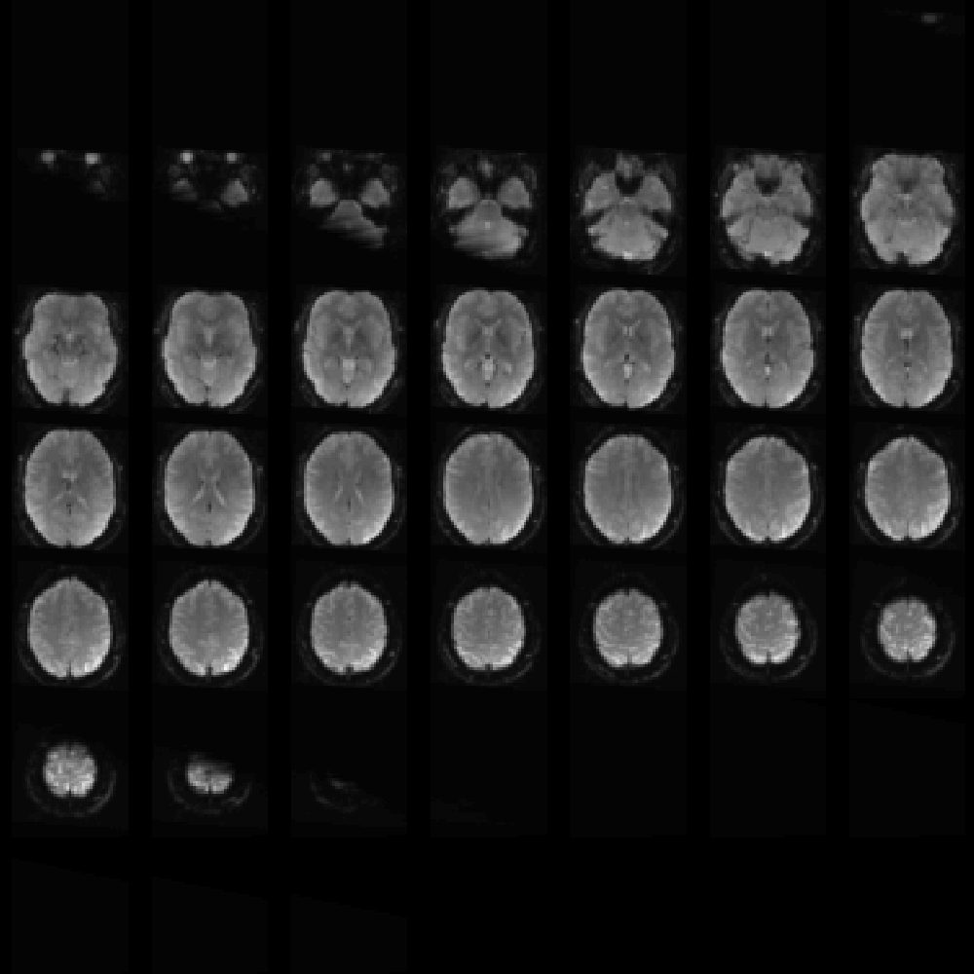

Slide 118
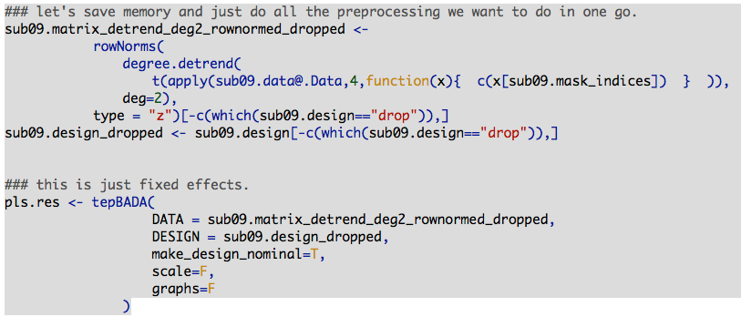
PLS in R

Slide 119
PLS in R

Slide 120
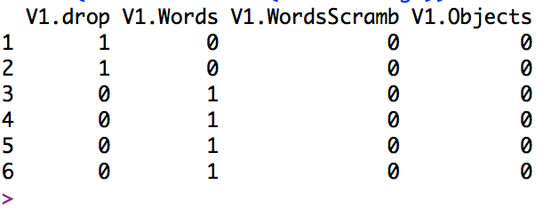
PLS in R

Slide 121
PLS in R

Slide 122
PLS: BADA
Barycentric discriminant analysis
a.k.a. mean-centered PLS
In this version:
Use all (preprocessed) time points
Use a design matrix for each time point
Analyze the averages of this design
We’re not dealing with the blocks
We average all TRs associated with each category

Slide 123
PLS: BADA
Inference
Not covered today
But available in R code and PLSGui

Slide 124
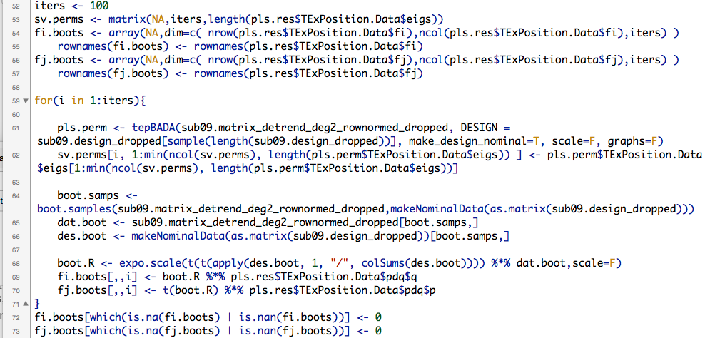
PLS in R

Slide 125
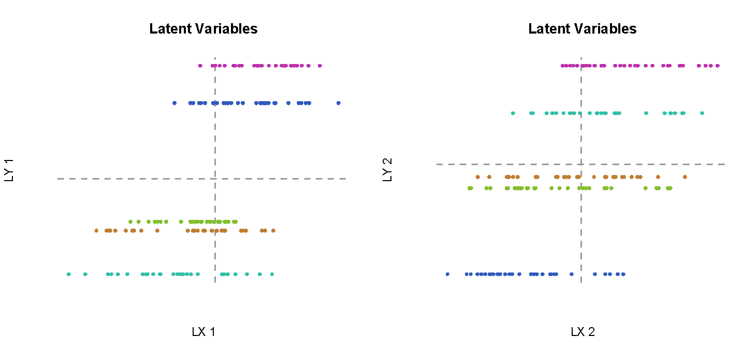
PLS in R

Slide 126
PLS in R
Brains
Brains

Slide 127
PLS in R
DESIGN
DESIGN

Slide 128
PLS in R
Individual Stimulus (time point)

Slide 129
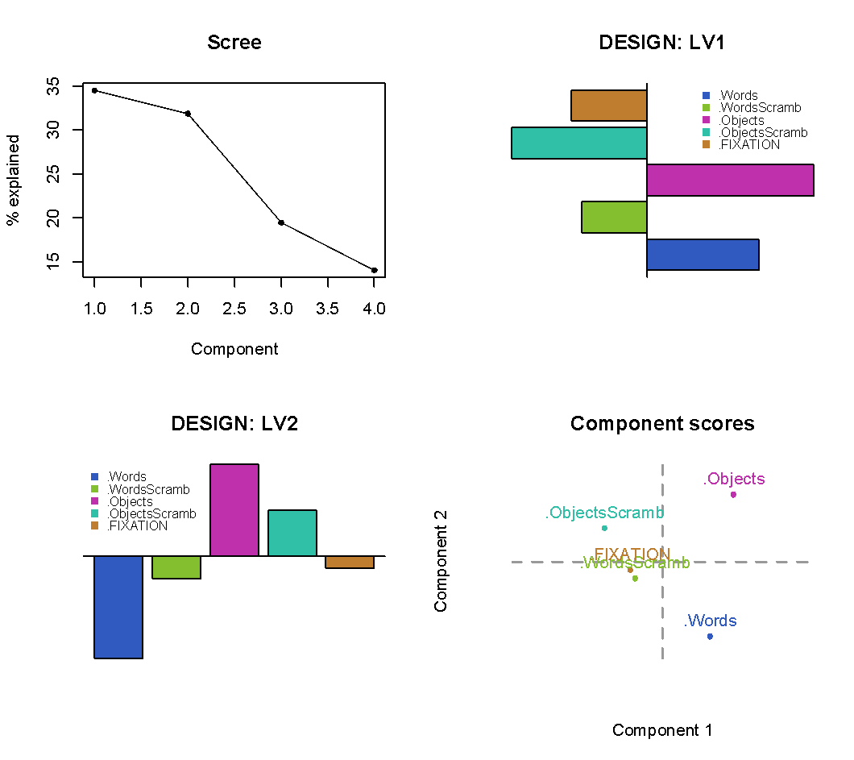
PLS in R

Slide 130
PLS in R

Slide 131
PLS in R

Slide 132
PLS in R

Slide 133
PLS in R
The story:
We have two components (LVs)
Component 1: Real vs. Not real stimuli
Component 2: Dissociate words from objects

Slide 134
PLS in R

Slide 135
PLS in R
Where are the brains?

Slide 136
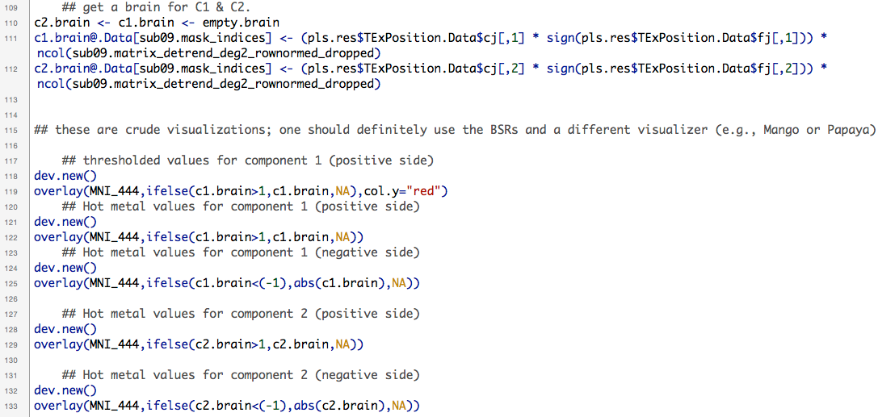
PLS in R

Slide 137
PLS in R

Slide 138


Slide 139
PLS in R

Slide 140
PLS in R

Slide 141


Slide 142
PLS in R

Slide 143
PLS in R

Slide 144


Slide 145


Slide 146
R summary
Read in single subject 4D data
Vectorize 3D brain (voxels) per time point
Create time x voxels matrix
Preprocess
Polynomial detrend & row normalization
PLS between
[Voxels over time] x [Which stimulus at each time point]
i.e., the average per category

Slide 147
R summary
We did this with
oro.nifti & TInPosition
There are other packages
neuroim (B. Buchsbaum)
Neuroconductor (lots of packages)
We’re working on a new package: MARINeR
“Multivariate analysis and resampling in neuroimaging in R”
Not ready yet
Interested in helping?
We’ll make pirate hats

Slide 148
Quick resampling refresher
Relevant for both PLSgui and R analyses
See: https://github.com/derekbeaton/Workshops/tree/master/RTC/Apr2017

Slide 149
Quick resampling refresher
Permutation
How many components are significant?
Scramble rows of one matrix and recompute PLS
Create a null distribution of eigenvalues
Bootstrap
Which variables significantly contribute to each component?
Resampling with replacement builds distributions around our variables
Confidence intervals
Bootstrap Ratios

Slide 150
A bit of a breather?

